Slide 2
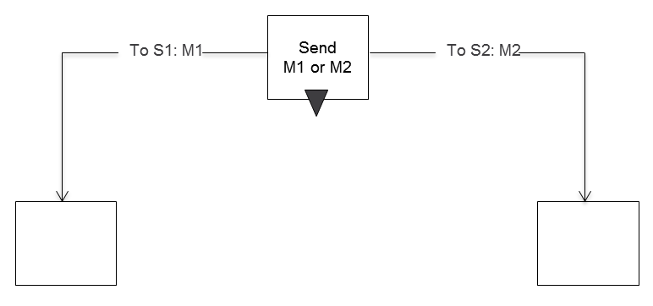
Send

Slide 3
Send Timeout

Slide 4
Receive

Slide 5
Receive Timer

Slide 6
Receive-Break

Slide 7
Symbols Behavior

Slide 8
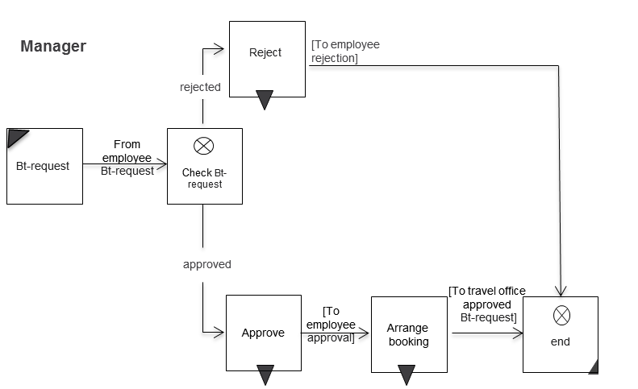
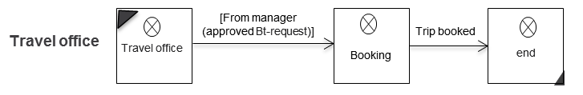
Beispiel

Slide 9
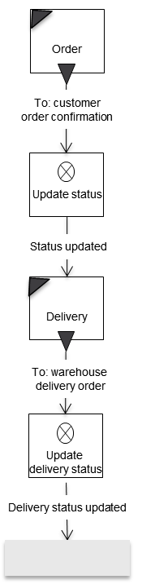
Macro

Slide 10
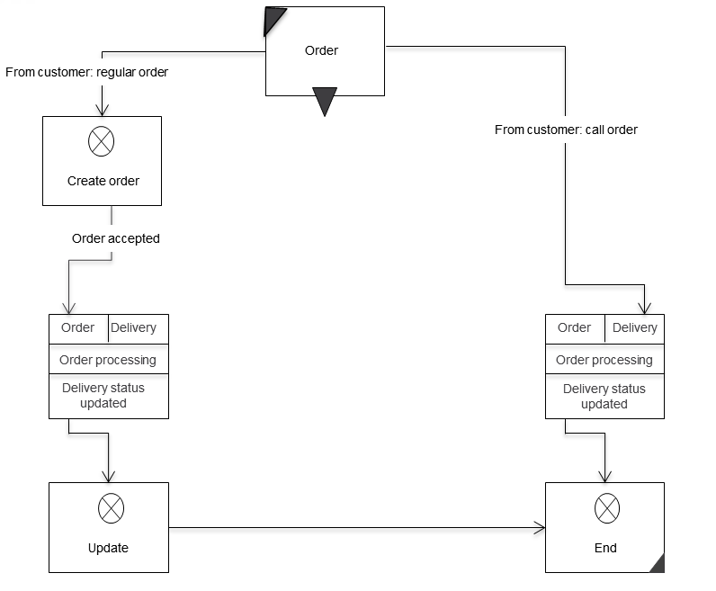
Macro Usage

Slide 11
Exception Handling

Slide 12
SID with Exception

Slide 13
Exception

Slide 14
Extension

Slide 15
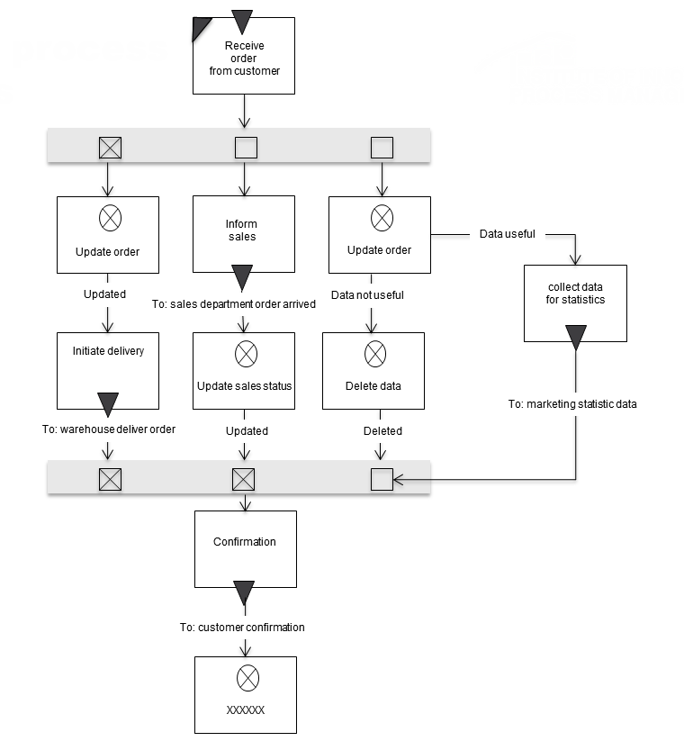
ALternative

Slide 16
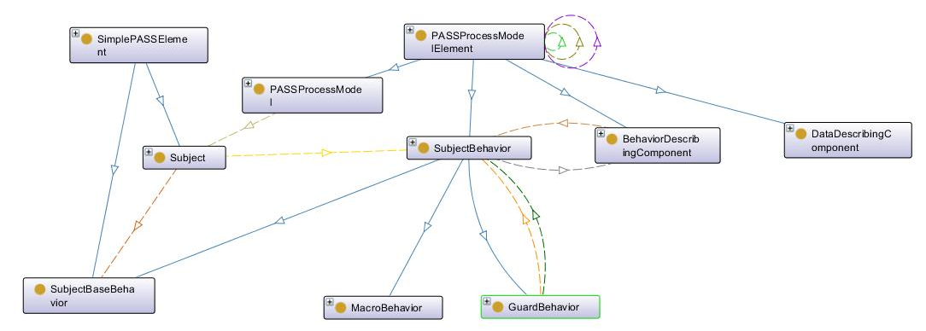
Relationship SimpleElements Processmodel
hasRelationTo ModelComponent
084
belongsTo
123
117
001
055
226
085
200
203
202
087
086
201
contains
088
203
201
guardsBehavior
guardsBehavior
containsBaseBehavior
containsBehavior

Slide 17
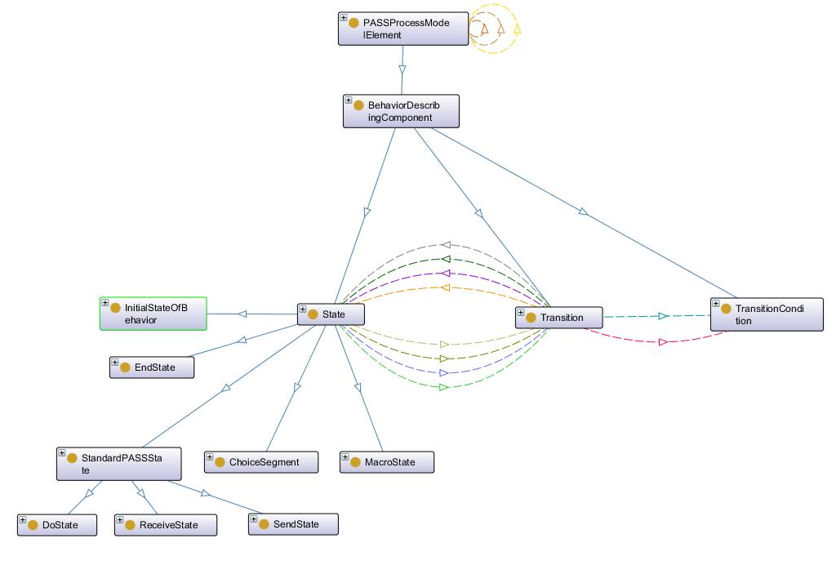
Behavior Describing Component
001
hasSourceState
030
046
hasTargetState
013
hasTransitionCondition
228
104
230
020
224
217
hasOutgoingTransition
025
014
024
hasIncomingTransition
114
115
116

Slide 18
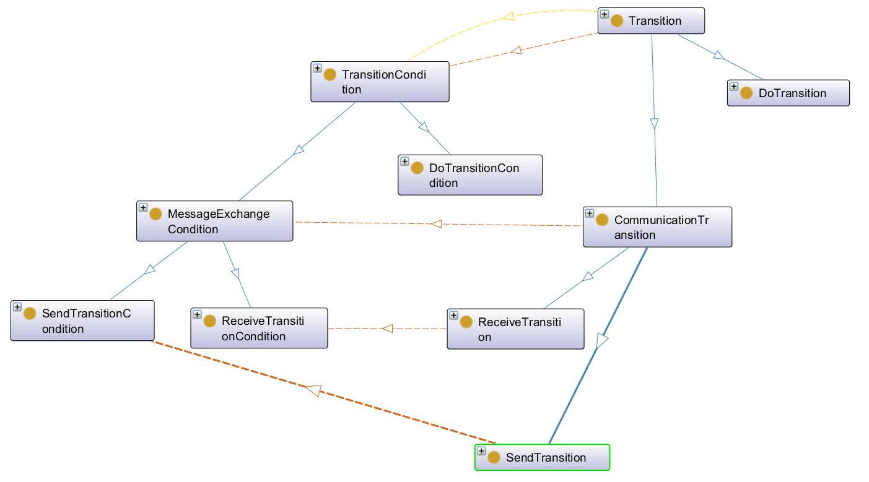
Transitions
hasTransitionCondition
hasTransitionCondition
231
101
031
034
048
047
231
050
049
032
033
231
hasTransitionCondition
hasTransitionCondition
231
hasTransitionCondition

Slide 19
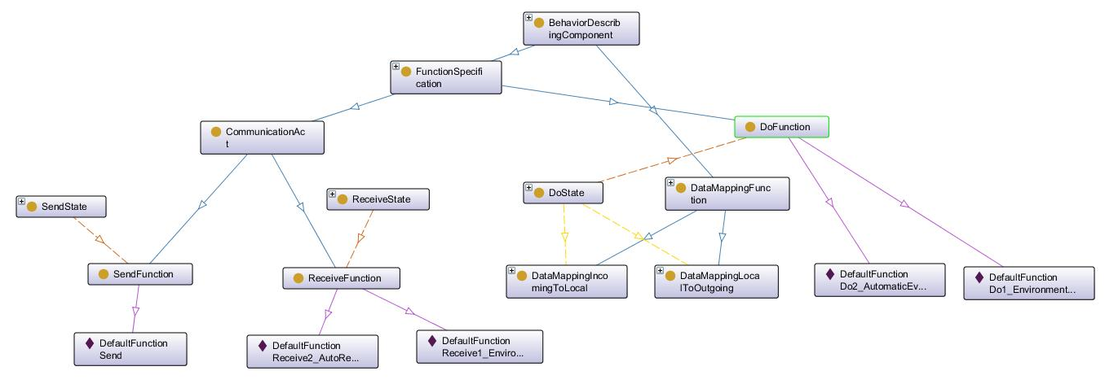
DataMapping
006
hasDataMappingFunction
003
hasFunctionSpecification
007
010
214
hasFunctionSpecification
hasDataMappingFunction
214
009
008
214
211
004
211
005
hasFunctionSpecification

Slide 20
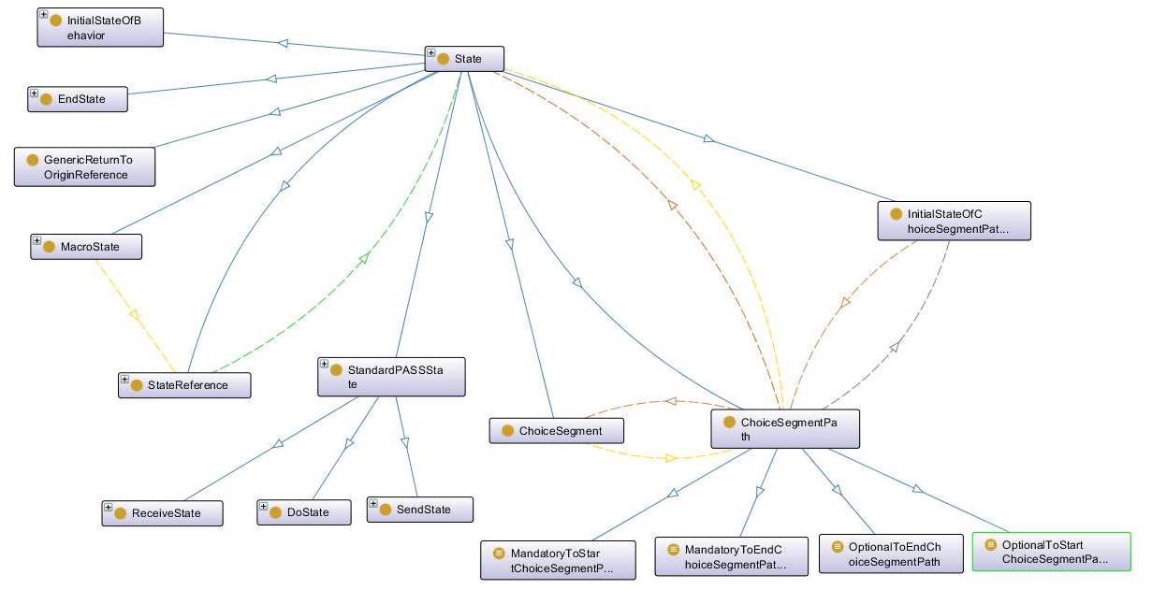
States
references
hasEndState
contains
hasInitialState
hasDataMappingFunction
belongsTo
belongsTo
contains

Slide 21
ASM STruktur
Behaviorsubj (D)
Behavior(subj, state)
Perform(subj, service(state), state)
Proceed(subj, X, node
Start(subj, X, Node)
InitializeBlockingTryRounds(subj ; state)
InitializeRoundAlternatives(subj ; state)

Slide 22
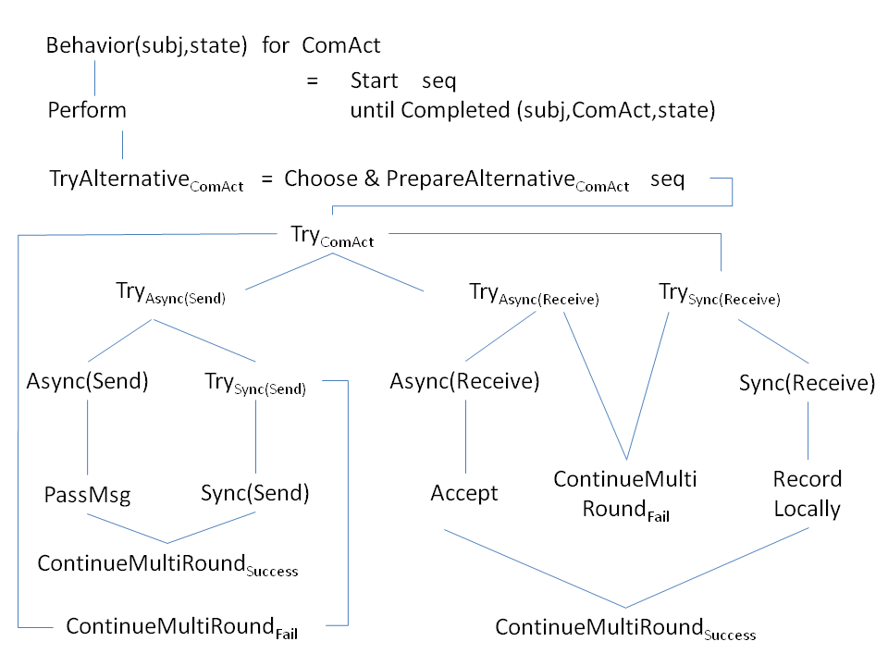

Slide 23
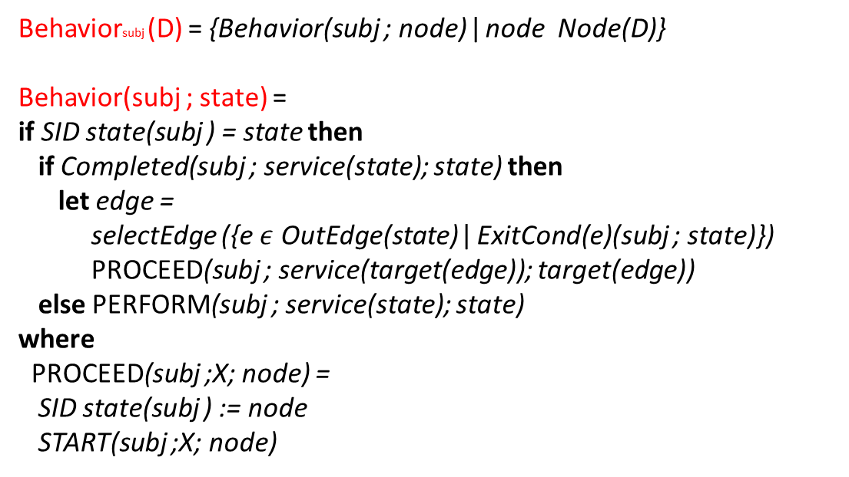
Behaviorsubj (D) = {Behavior(subj ; node) ǀ node Node(D)}
Behavior(subj ; state) =
if SID state(subj ) = state then
if Completed(subj ; service(state); state) then
let edge =
selectEdge ({e $ε$ OutEdge(state) ǀ ExitCond(e)(subj ; state)})
PROCEED(subj ; service(target(edge)); target(edge))
else PERFORM(subj ; service(state); state)
where
PROCEED(subj ;X; node) =
SID state(subj ) := node
START(subj ;X; node)

Slide 24
Perform(subj ;DoAct; state) =
Start and Perform together with the
completion predicate Completed

Slide 25
Perform Communication
Perform(subj ;ComAct; state) =
if NonBlockingTryRound(subj ; state) then
if TryRoundFinished(subj ; state) then
INITIALIZEBLOCKINGTRYROUNDS(subj ; state)
else TRYALTERNATIVEComAct (subj ; state)
if BlockingTryRound(subj ; state) then
if TryRoundFinished(subj ; state)
then INITIALIZEROUNDALTERNATIVES(subj ; state)
else
if Timeout(subj ; state; timeout(state)) then
INTERRUPTComAct (subj ; state)
elseif UserAbruption(subj ; state)
then AbruptComAct (subj ; state)
else TRYALTERNATIVEComAct (subj ; state)

Slide 27
start
START(subj ;COMACT; state) =
INITIALIZEROUNDALTERNATIVES(subj ; state)
INITIALIZEEXIT&COMPLETIONPREDICATESComAct (subj ; state)
ENTERNONBLOCKINGTRYROUND(subj ; state)
where
INITIALIZEROUNDALTERNATIVES(subj ; state) =
RoundAlternative(subj ; state) := Alternative(subj ; state)
INITIALIZEEXIT&COMPLETIONPREDICATESComAct (subj ; state) =
INITIALIZEEXITPREDICATESComAct (subj ; state)
INITIALIZECOMPLETIONPREDICATEComAct (subj ; state)
INITIALIZEEXITPREDICATESComAct (subj ; state) =
NormalExitCond(subj ;COMACT; state) := false
TimeoutExitCond(subj ;COMACT; state) := false
AbruptionExitCond(subj ;COMACT; state) := false
INITIALIZECOMPLETIONPREDICATEComAct (subj ; state) =
Completed(subj ;COMACT; state) := false

Slide 28
Non blocking try run
[Non]BlockingTryRound(subj ; state) =
tryMode(subj ; state) = [non]blocking
ENTER[NON]BLOCKINGTRYROUND(subj ; state) =
tryMode(subj ; state) := [non]blocking
TryRoundFinished(subj ; state) =
RoundAlternatives(subj ; state) = ;
INITIALIZEBLOCKINGTRYROUNDS(subj ; state) =
ENTERBLOCKINGTRYROUND(subj ; state)
INITIALIZEROUNDALTERNATIVES(subj ; state)
SETTIMEOUTCLOCK(subj ; state)
SETTIMEOUTCLOCK(subj ; state) =
blockingStartTime(subj ; state) := now
Timeout(subj ; state; time) =
now >= blockingStartTime(subj ; state) + time

Slide 29
Interrupt
INTERRUPTComAct (subj ; state) =
SETCOMPLETIONPREDICATEComAct (subj ; state)
SETTIMEOUTEXITComAct (subj ; state)
SETCOMPLETIONPREDICATEComAct (subj ; state) =
Completed(subj ;COMACT; state) := true
SETTIMEOUTEXITComAct (subj ; state) =
TimeoutExitCond(subj ;COMACT; state) := true
ABRUPTComAct (subj ; state) =
SETCOMPLETIONPREDICATEComAct (subj ; state)
SETABRUPTIONEXITComAct (subj ; state)

Slide 30
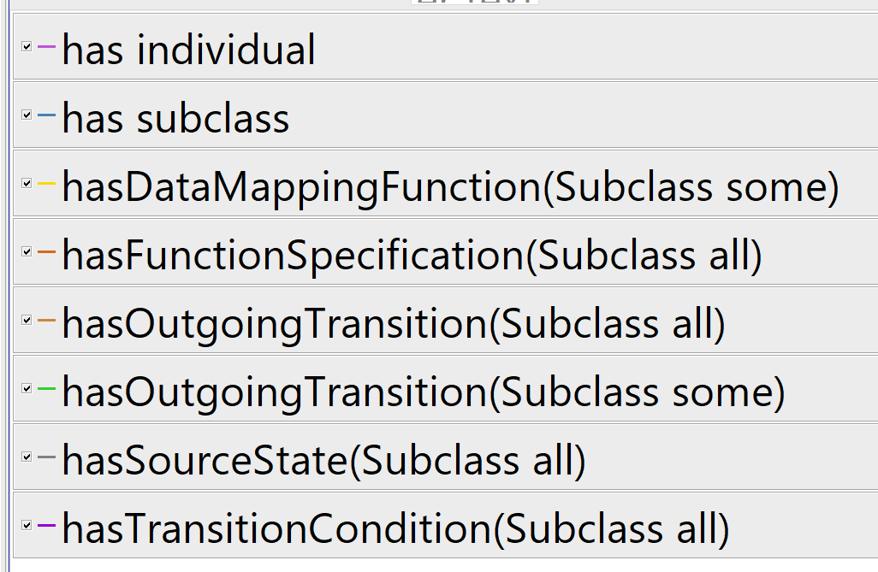
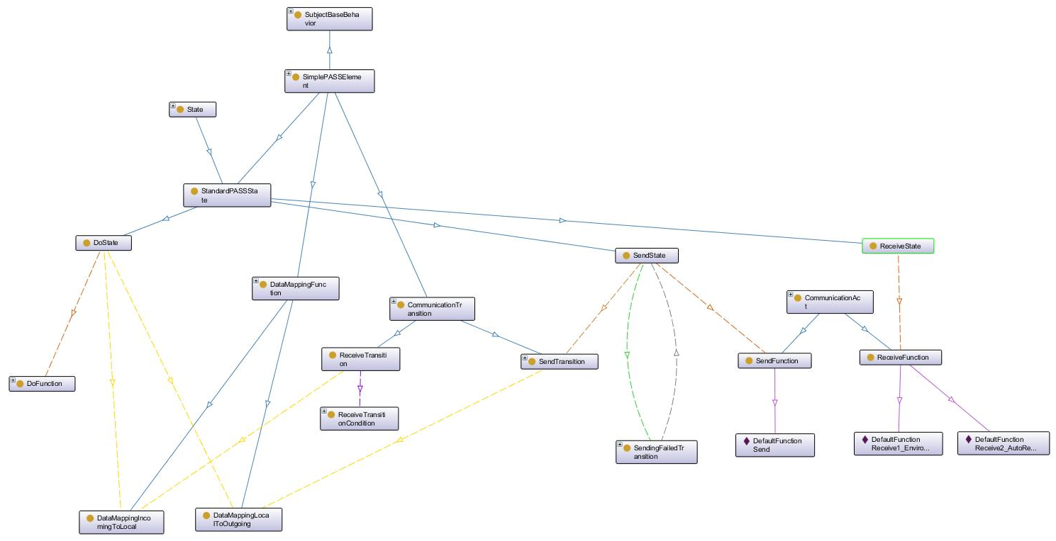
Required Simple PASS Components
123
025
101
093
090
114
116
115
101
101
091
101
101
101
101
101
092
102
101
095
094
101
101
101

Slide 31
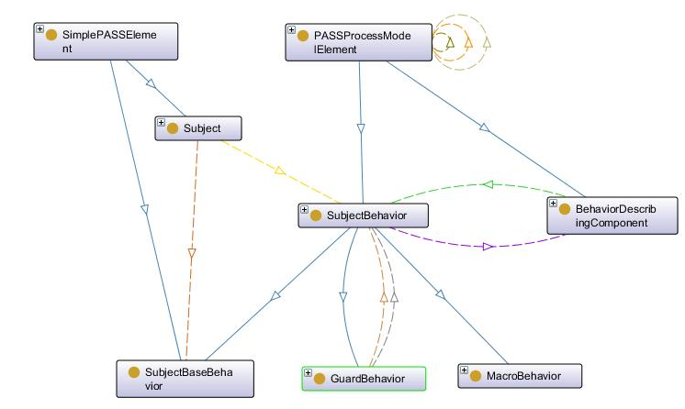
Subject Behavior
123
117
085
001
belongsto
containsBehavior
203
200
202
containsBaseBehavior
201
088
086
206
087
contains
guardBehavior

Slide 32
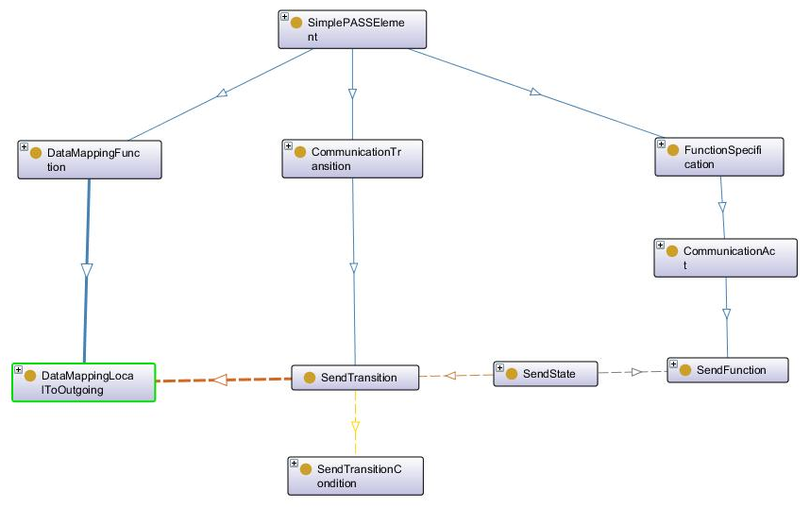
Send Action
093
090
101
095
092
099
100
211
224
214
231

Slide 33
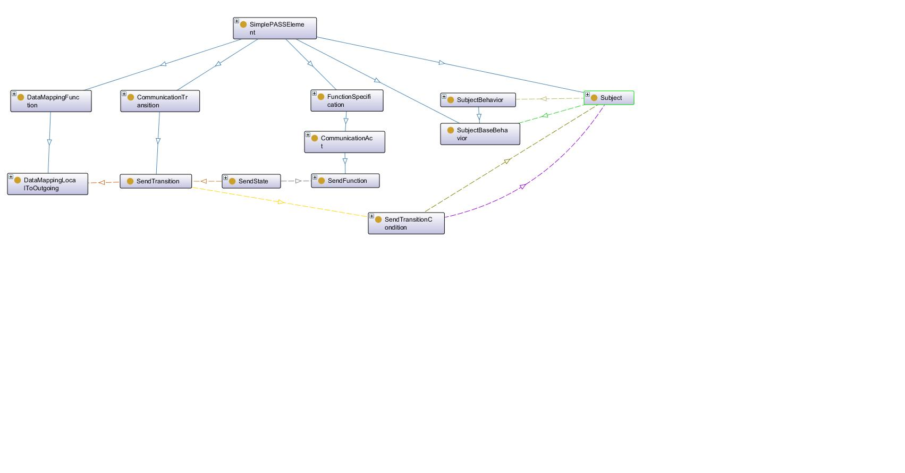
Action Send SUbject

Slide 34
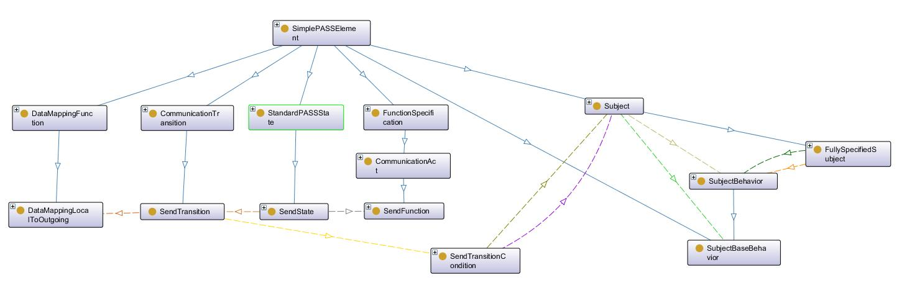

Slide 35
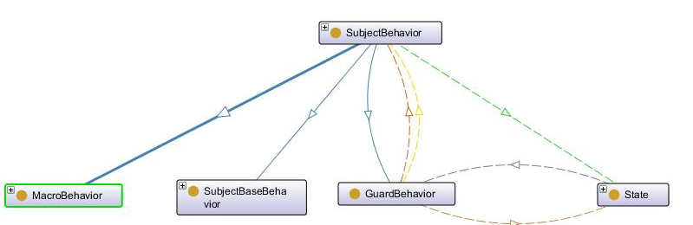
Behavior-Guard
101
101
101
101
101
101
101
101
101
101
101
101
101
101
101
101

Slide 36
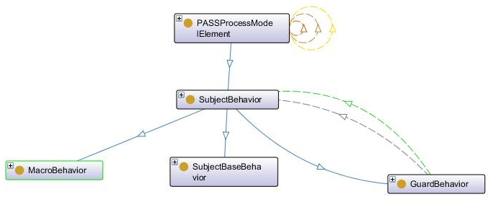
Subject Behavior
085
206
087
088
086

Slide 37
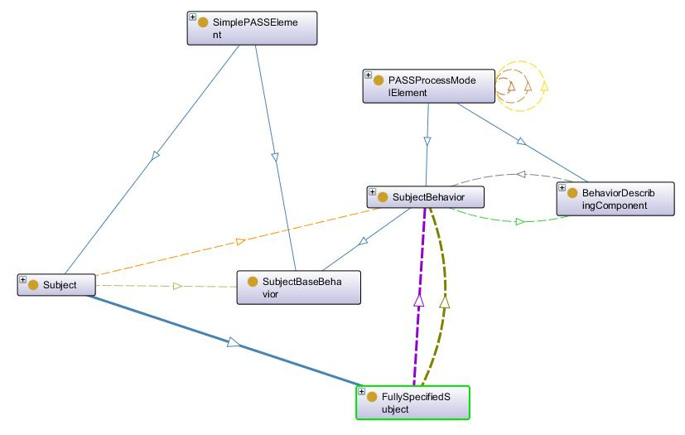
Subject Behavior alt
belongsto
117
123
085
001
containsBehavior
200
088
201
203
202
203
202
contains
118
containsBaseBehavior
containsBehavior
containsBaseBehavior

Slide 38
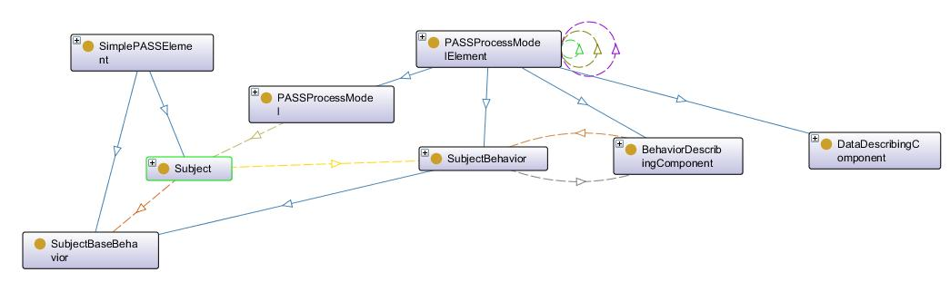
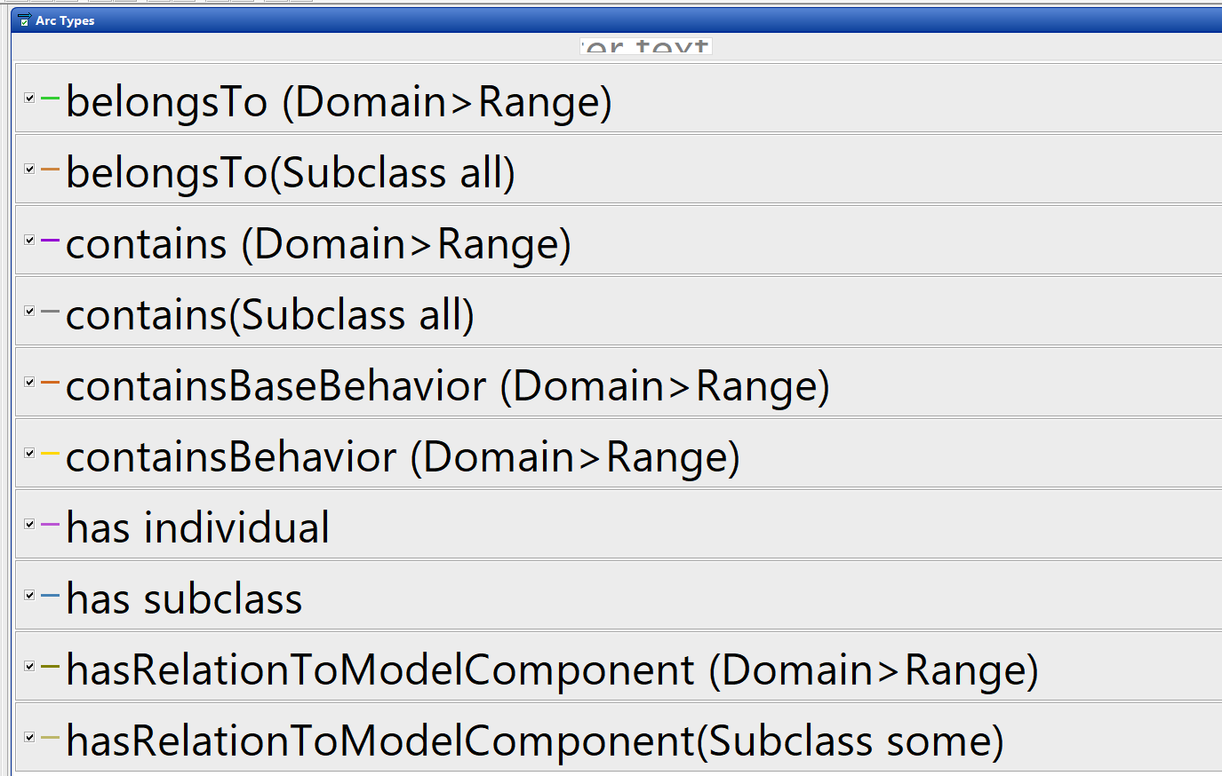
Relationship SimpleElements Processmodel
084
belongsTo
123
117
001
055
085
200
226
203
202
201
088
containsBehavior
contains
containsBaseBehavior
hasRelationTo ModelComponent

